Slide 1



TOOLKIT CASCADE TRAINING INTERNATIONALISATION OF HIGHER EDUCATION
SOUPHANOUVONG UNIVERSITY
1st December 2021
By: Thongkham HUNGSAVATH
E-mail: thongkham.hsv@gmail.com
SOUPHANOUVONG UNIVERSITY

Slide 2

Internationalisation of Higher Education
Internationalization of HE is the intentional process of integrating an international, intercultural or global dimension into purpose, functions and delivery of post secondary education, in order to enhance the quality of education and research for all students and staff, and to make a meaningful contribution to society. Jane Knigth (2015)
Internationalisation is a means implement
strategic goals and priorities.
SOUPHANOUVONG UNIVERSITY

Slide 3
Why internationalise?
Scholarship is borderless
Access to talent: universities want to attract top scholars from around the world
Access to opportunities; students want to travel to the best institutions
Resources: international contacts come with funding attached; international students pay fees.
To meet national development goals and SDGs.
International profile and rankings.
SOUPHANOUVONG UNIVERSITY

Slide 4
Internationalisation coming into focus
Internationalisation strategies
Research
Studies
Reputation
Infrastructure
Budget
Strategic partnership
Organisational strategies have to Ensure that programme strategies are supported on the institutional level:
Support of the authorities
Commitment of staff
Responsible people and
adequate staffing
Adequate tools (Data bases IT
support)
Adequate financial support
Incentive system for the staff
Internal communication
SOUPHANOUVONG UNIVERSITY

Slide 5
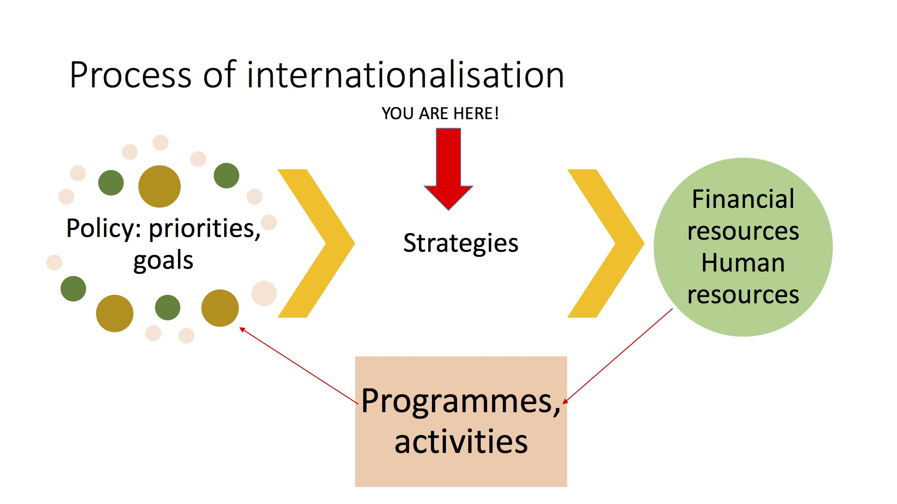
Process of internationalisation
Erasmus TOOLKIT_Internationalisation strategies
SOUPHANOUVONG UNIVERSITY

Slide 6
Factors influencing the internationalisation strategy
External factors
Competitiveness
Reputation
HEI place in the market
Legal regulations
National Priorities
Internal Factors
HEI vision and mission
HEI culture and traditions
Priorities and ambitions
Human and financial resources
HEI structure and infrastructure
SOUPHANOUVONG UNIVERSITY

Slide 7
The main elements of any (internationalisation) strategy
Vision: where we aim to be in the future?
Mission: why we are here? what is our strength and value to society?
Values: what we adhere to in our mission? Inclusive policy/tolerance/student oriented
SWOT and/or state of affairs report
Goals: realistic and achievable
Work plan: SMART –specific, measurable, accurate, realistic, time-bound
SOUPHANOUVONG UNIVERSITY

Slide 8
Internationalisation strategic plan need to be:
Approved by the university governing bodies
Shared with the university and other faculties and departments
Made public
SOUPHANOUVONG UNIVERSITY

Slide 9
Souphanouvong University
Thank You for Your Attention
Any Questions?
SOUPHANOUVONG UNIVERSITY

